Slide 1

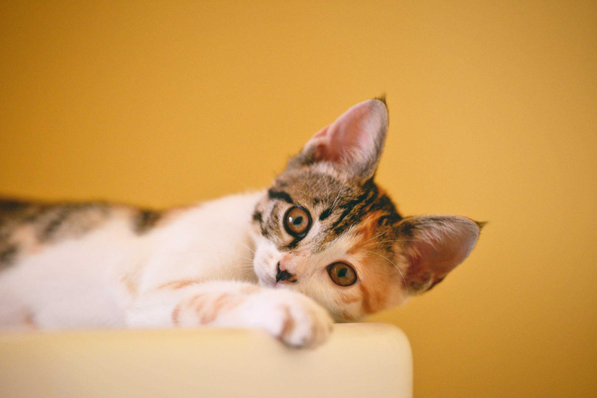






Pet FeedeR
rProject
BY GROUP 5 SE1840
Teacher Lê Vũ Trường

Slide 2





Methods and Materials
group 5
TRẦN MẠNH TUẤN
1.TRẦN MẠNH TUẤN
2.LÊ TIẾN ĐẠT
3. NGUYỄN HỮU ĐẠT
4.CUNG NGUYỄN BÍCH TRÂM

Slide 3
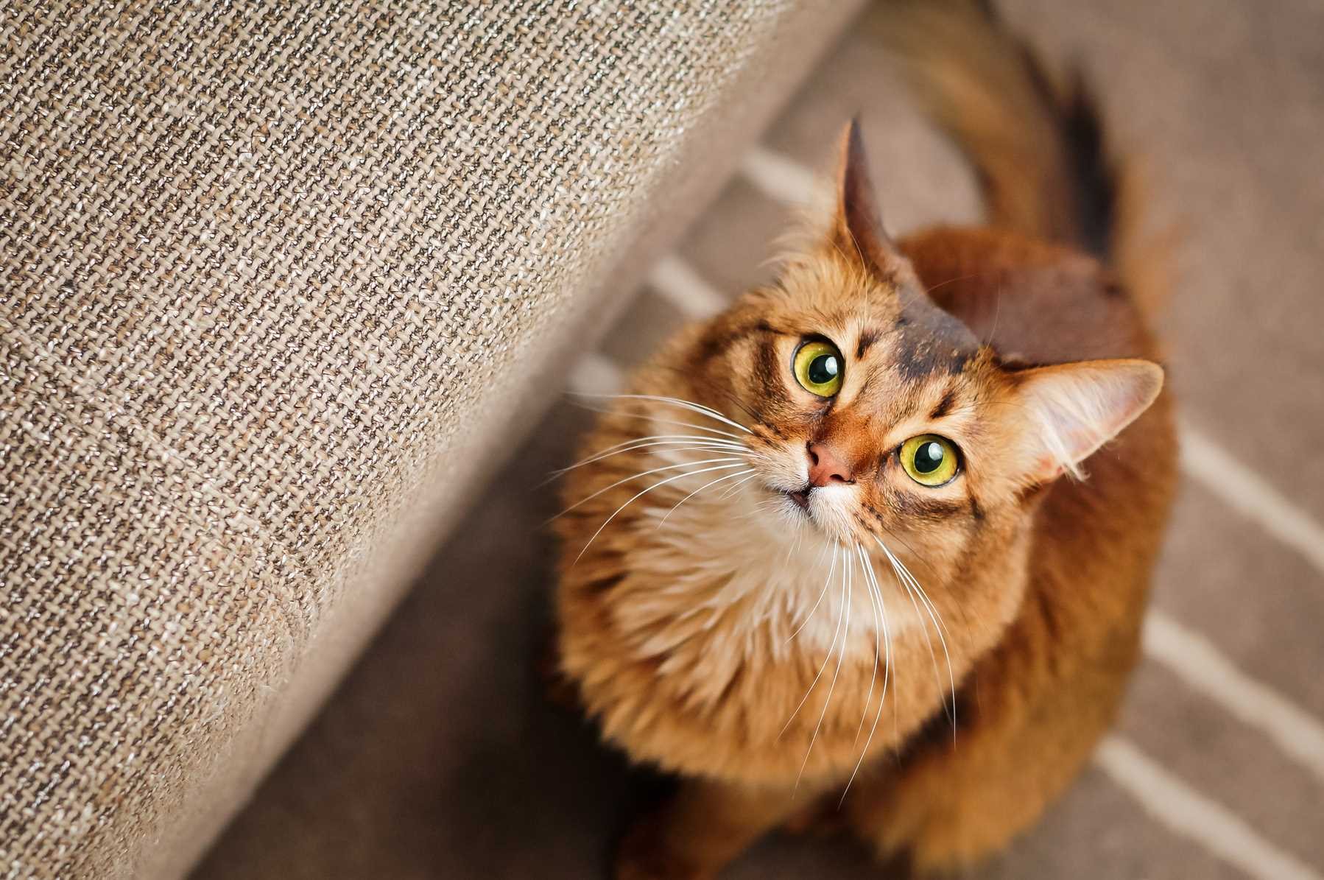
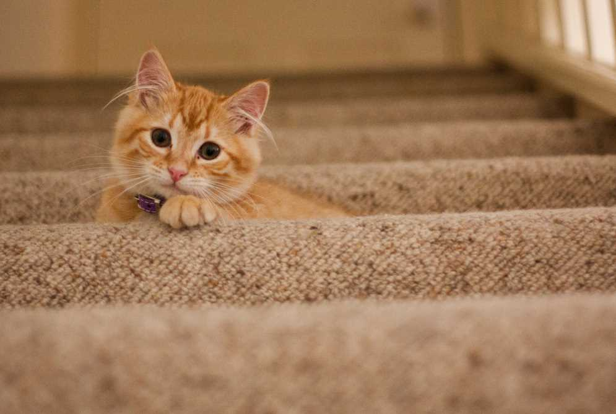
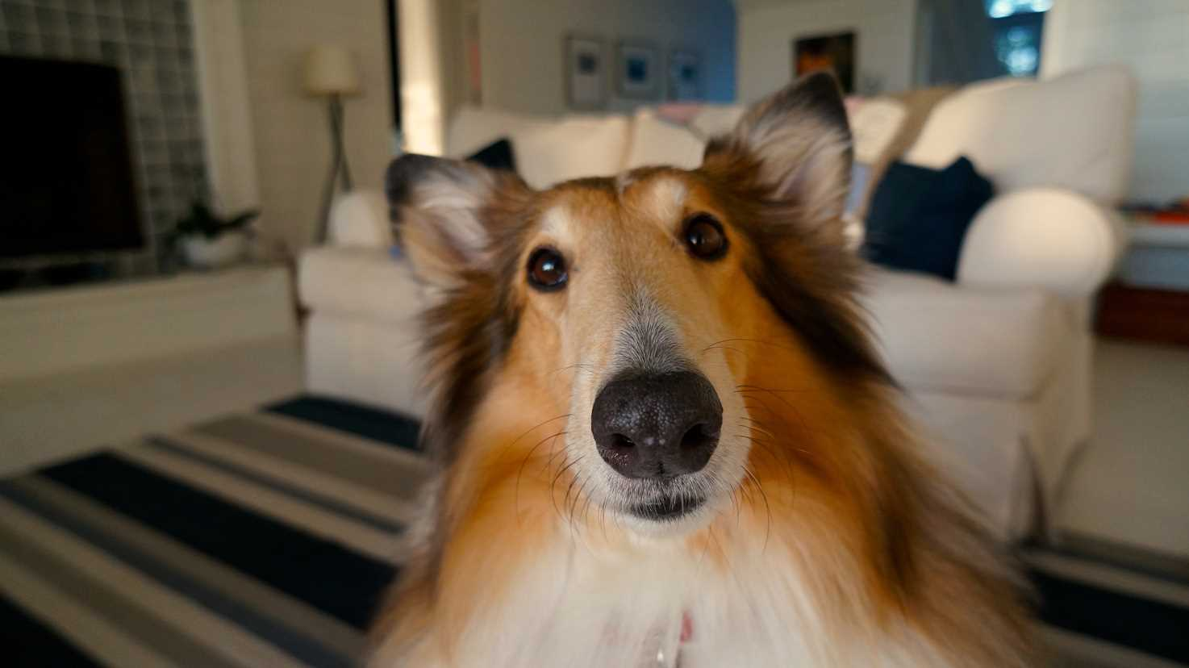
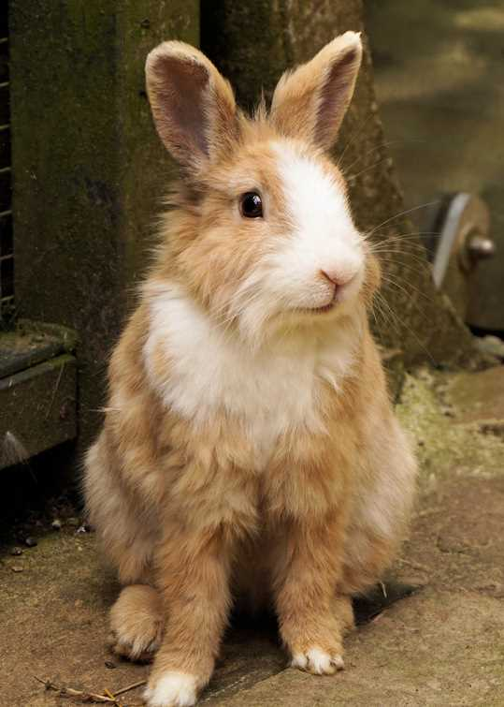
table of Content
01
Introduction the Group
02
Introduction for Project
03
Methods and Materials
04
Result and Discussion
05
Conclusion
06
Q&A

Slide 4


Introduction for
Project
In an increasingly digital and busy world, pet care, especially ensuring timely and proper feeding, has become difficult for those with busy schedules. Traditional feeding methods can cause problems such as obesity or malnutrition for pets. To solve this problem, Internet of Things (IoT) technology is used to develop automated feeding systems. The Pet Feeder project provides a solution to automate the feeding process, allowing pet owners to remotely control via a mobile app, helping to schedule feedings and adjust portions. The system also uses sensors to ensure the correct amount of food, avoiding overfeeding or underfeeding. The project not only meets practical needs but also fits the trend of smart homes, helping to improve the quality of pet care in modern life.

Slide 5
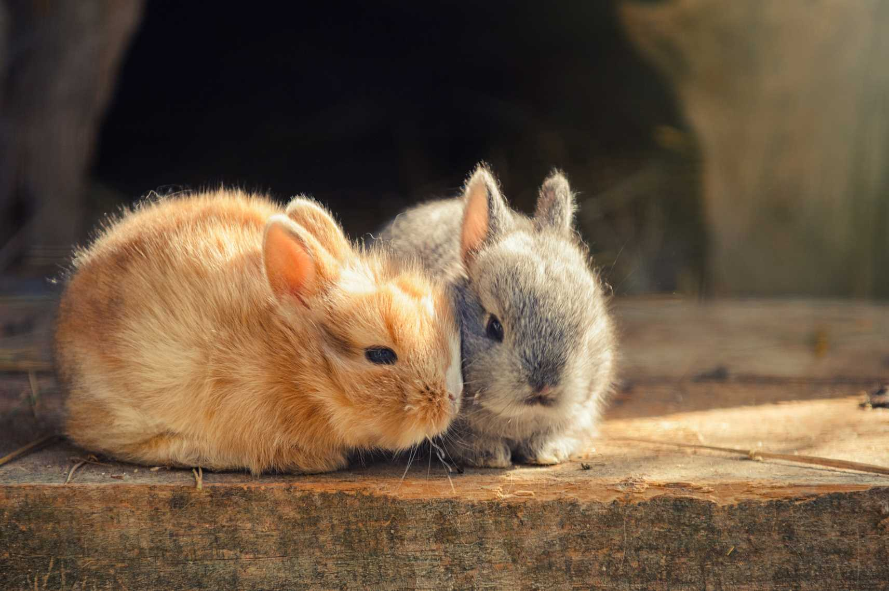
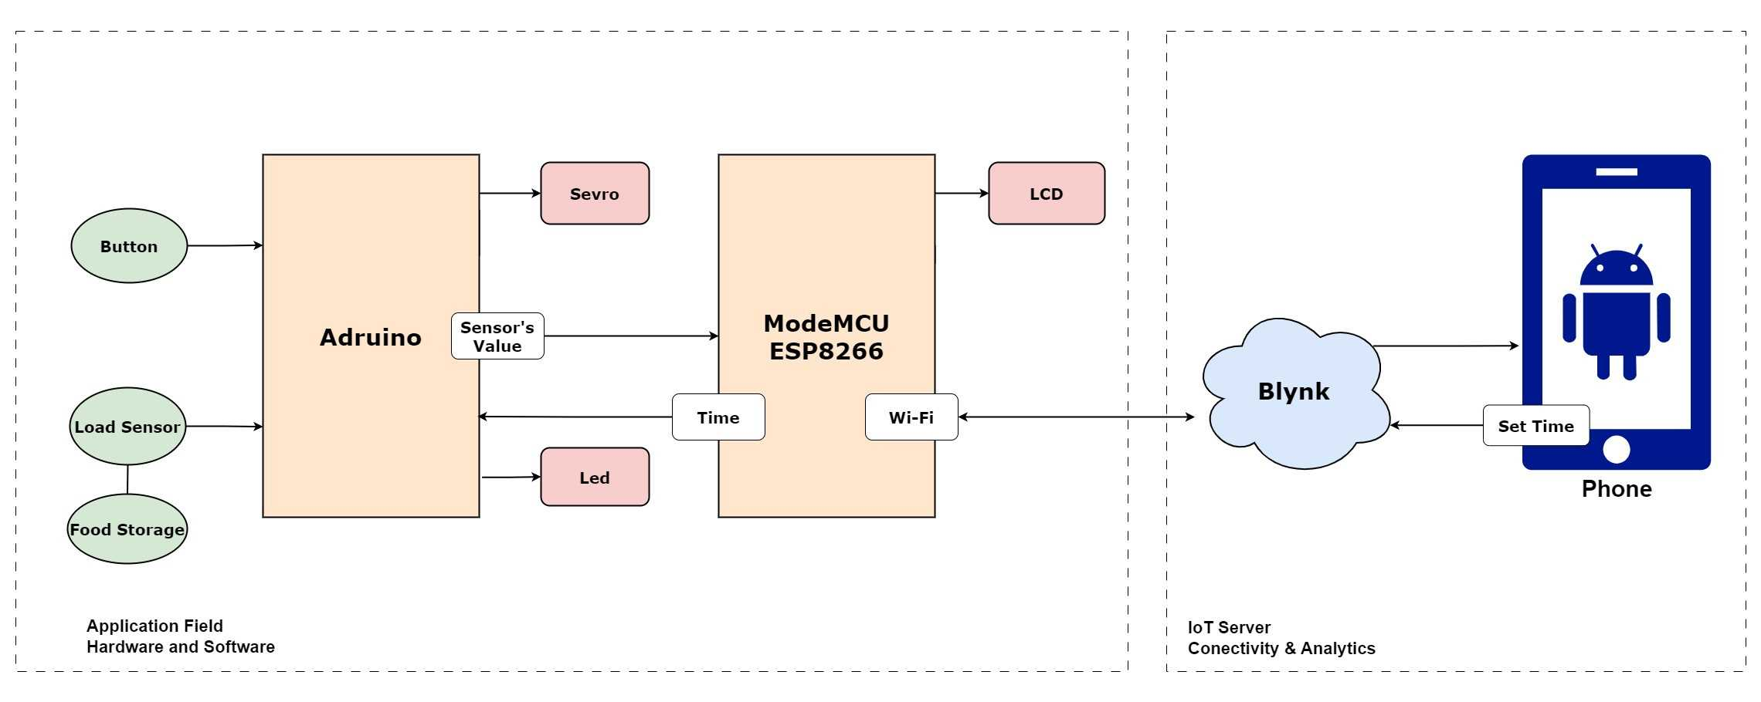
Methods and Materials
2.1. System Model and Block Diagram

Slide 6
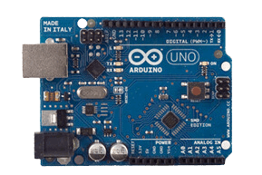
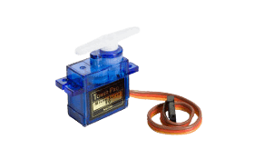
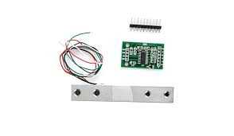
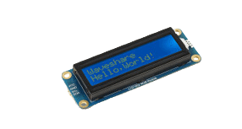
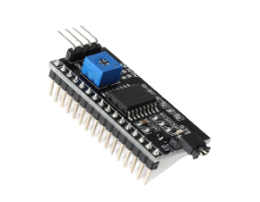
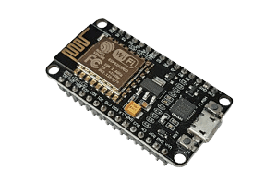
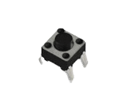
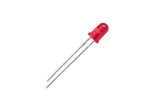
Methods and Materials
2.2. Components and Peripheral Devices
Arduino Uno
Servo Motor
Load Cell Sensor
ESP8266 NodeMCU V1.0
LCD 1602
I2C Interface
Led and Button

Slide 7
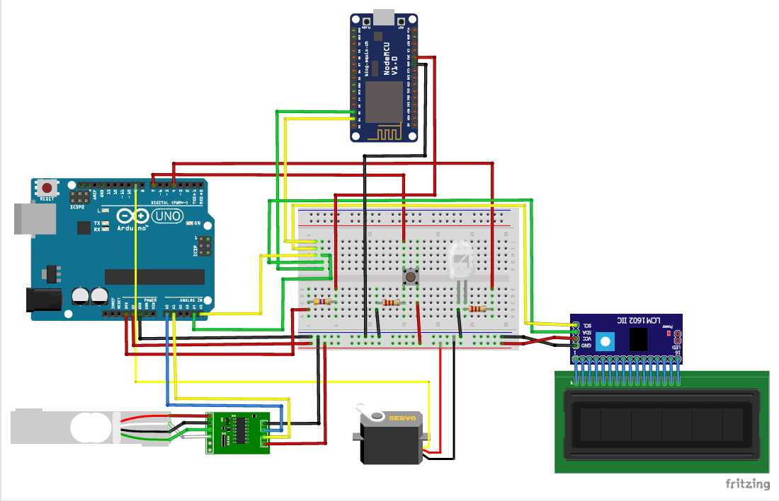
Methods and Materials
2.3. Electronic Circuit/Hardware Interfacing

Slide 8
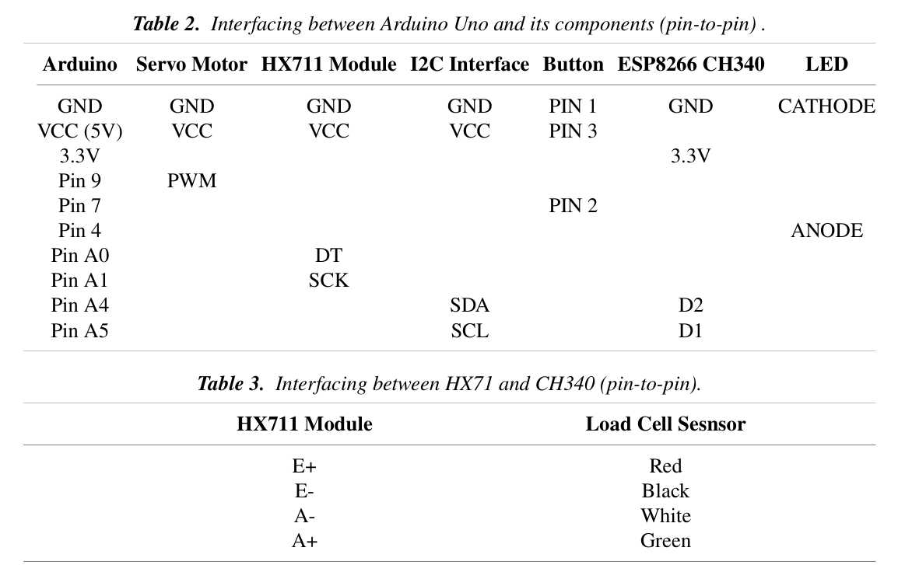
Methods and Materials
2.3. Electronic Circuit/Hardware Interfacing

Slide 9
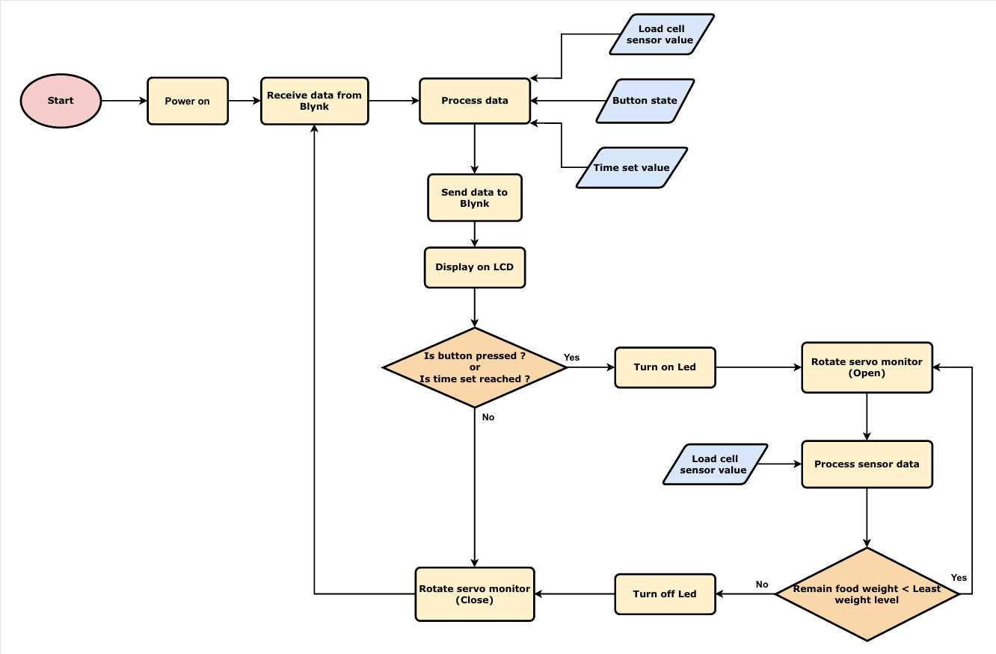
Methods and Materials
2.4. Programming Flowchart

Slide 10
Result and Discussion
3.1. Prototype Implementation
The Pet Feeder System prototype was developed using an Arduino Uno as the central microcontroller, integrating various components like a servo motor, load sensor, ESP8266 NodeMCU, and LED indicators. The system was assembled on a full-size MB-102 breadboard and powered mostly by a 5V DC supply, except for the OLED screen, which used a 3.3V DC source. The code for the system was written in the Arduino IDE and flashed onto the Arduino and ESP8266 to control feeding times and portion sizes, either automatically or manually through the Blynk mobile app.
The prototype was tested to ensure proper operation of the load sensor for food level measurement, the servo motor for food dispensing, and communication between the ESP8266 and the mobile app for remote control. The fully functional system was evaluated under real-world conditions to verify its effectiveness and reliability in automating pet feeding

Slide 11
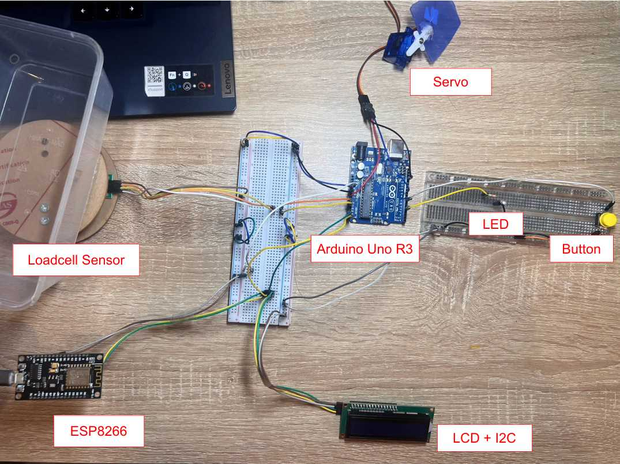
Result and Discussion
3.2. Results from Prototype Testing

Slide 12
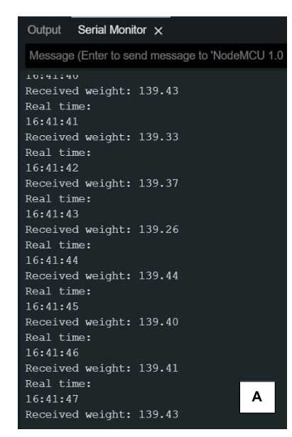
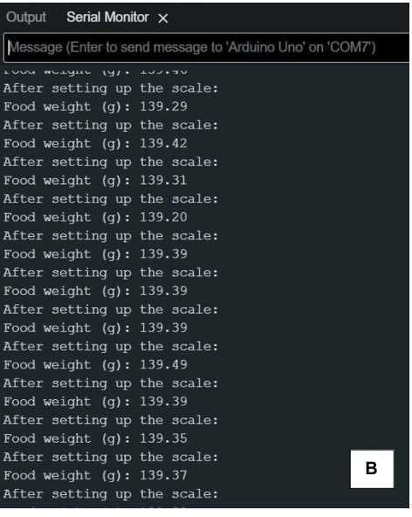
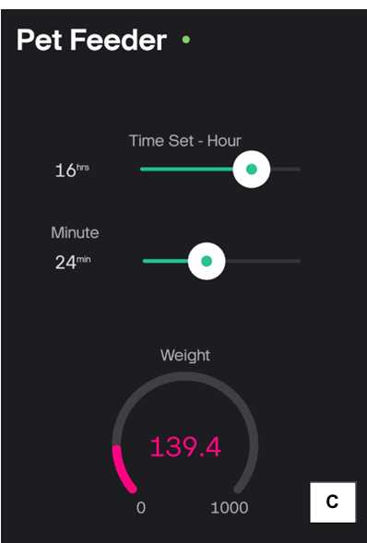
Result and Discussion
3.2. Results from Prototype Testing

Slide 13
Result and Discussion
3.3. Discussion
The Pet Feeder system demonstrates high accuracy in food measurement and reliable automation in feeding, enhanced by the Blynk interface for remote control. Limitations include data synchronization delays between the NodeMCU and Blynk app, affecting responsiveness when quick adjustments are necessary. Currently, the system lacks a low-food alert feature, risking unnoticed shortages, particularly when manual checks are impractical. Planned upgrades aim to add this alert and integrate voice controls, enhancing user interaction and ensuring consistent feeding. Overall, the Pet Feeder effectively supports automated pet care and shows promise for further improvements for busy pet owners.

Slide 14
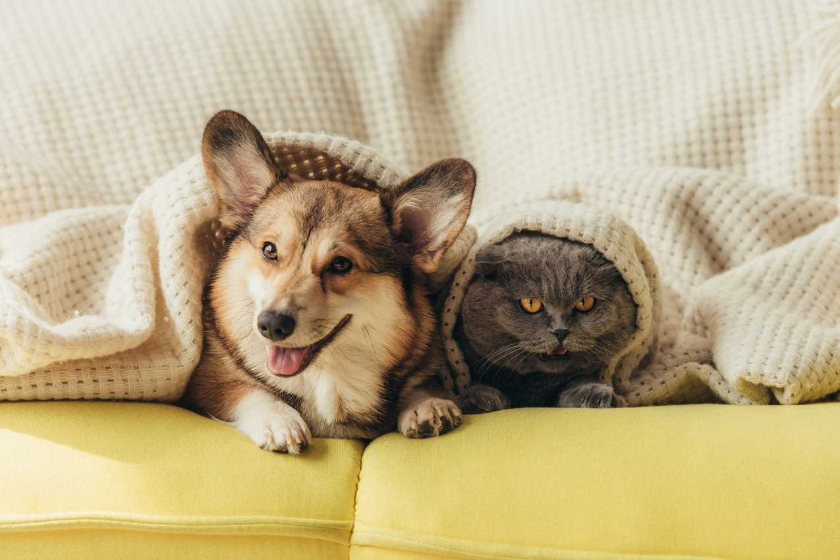
Conclusion

Slide 15
Conclusion
The Pet Feeder system developed in this project provides an efficient and automated solution for managing pet feeding schedules. By integrating components such as the load cell sensor, HX711 module, ESP8266 Wi-Fi module, and a simple interface with buttons and LEDs, the system ensures precise food dispensing and real-time monitoring through a mobile application. The use of the I2C communication protocol and NodeMCU enhances the flexibility and scalability of the system, allowing for easy integration of additional features in the future.
This automated pet feeder improves the convenience and reliability of pet care, especially for busy pet owners who may not always be home during feeding times. Additionally, it ensures that pets are fed the correct amount of food, preventing overfeeding or underfeeding. With the system’s user-friendly interface and its ability to remotely monitor and control the feeding process, this project demonstrates the practical application of IoT and embedded systems in everyday life. Future developments could include additional sensors or smart features, such as integration with voice assistants or more advanced data analytics for tracking feeding habits over time.

Slide 16

Thank
you
BY GROUP_5 SE1840

Slide 17
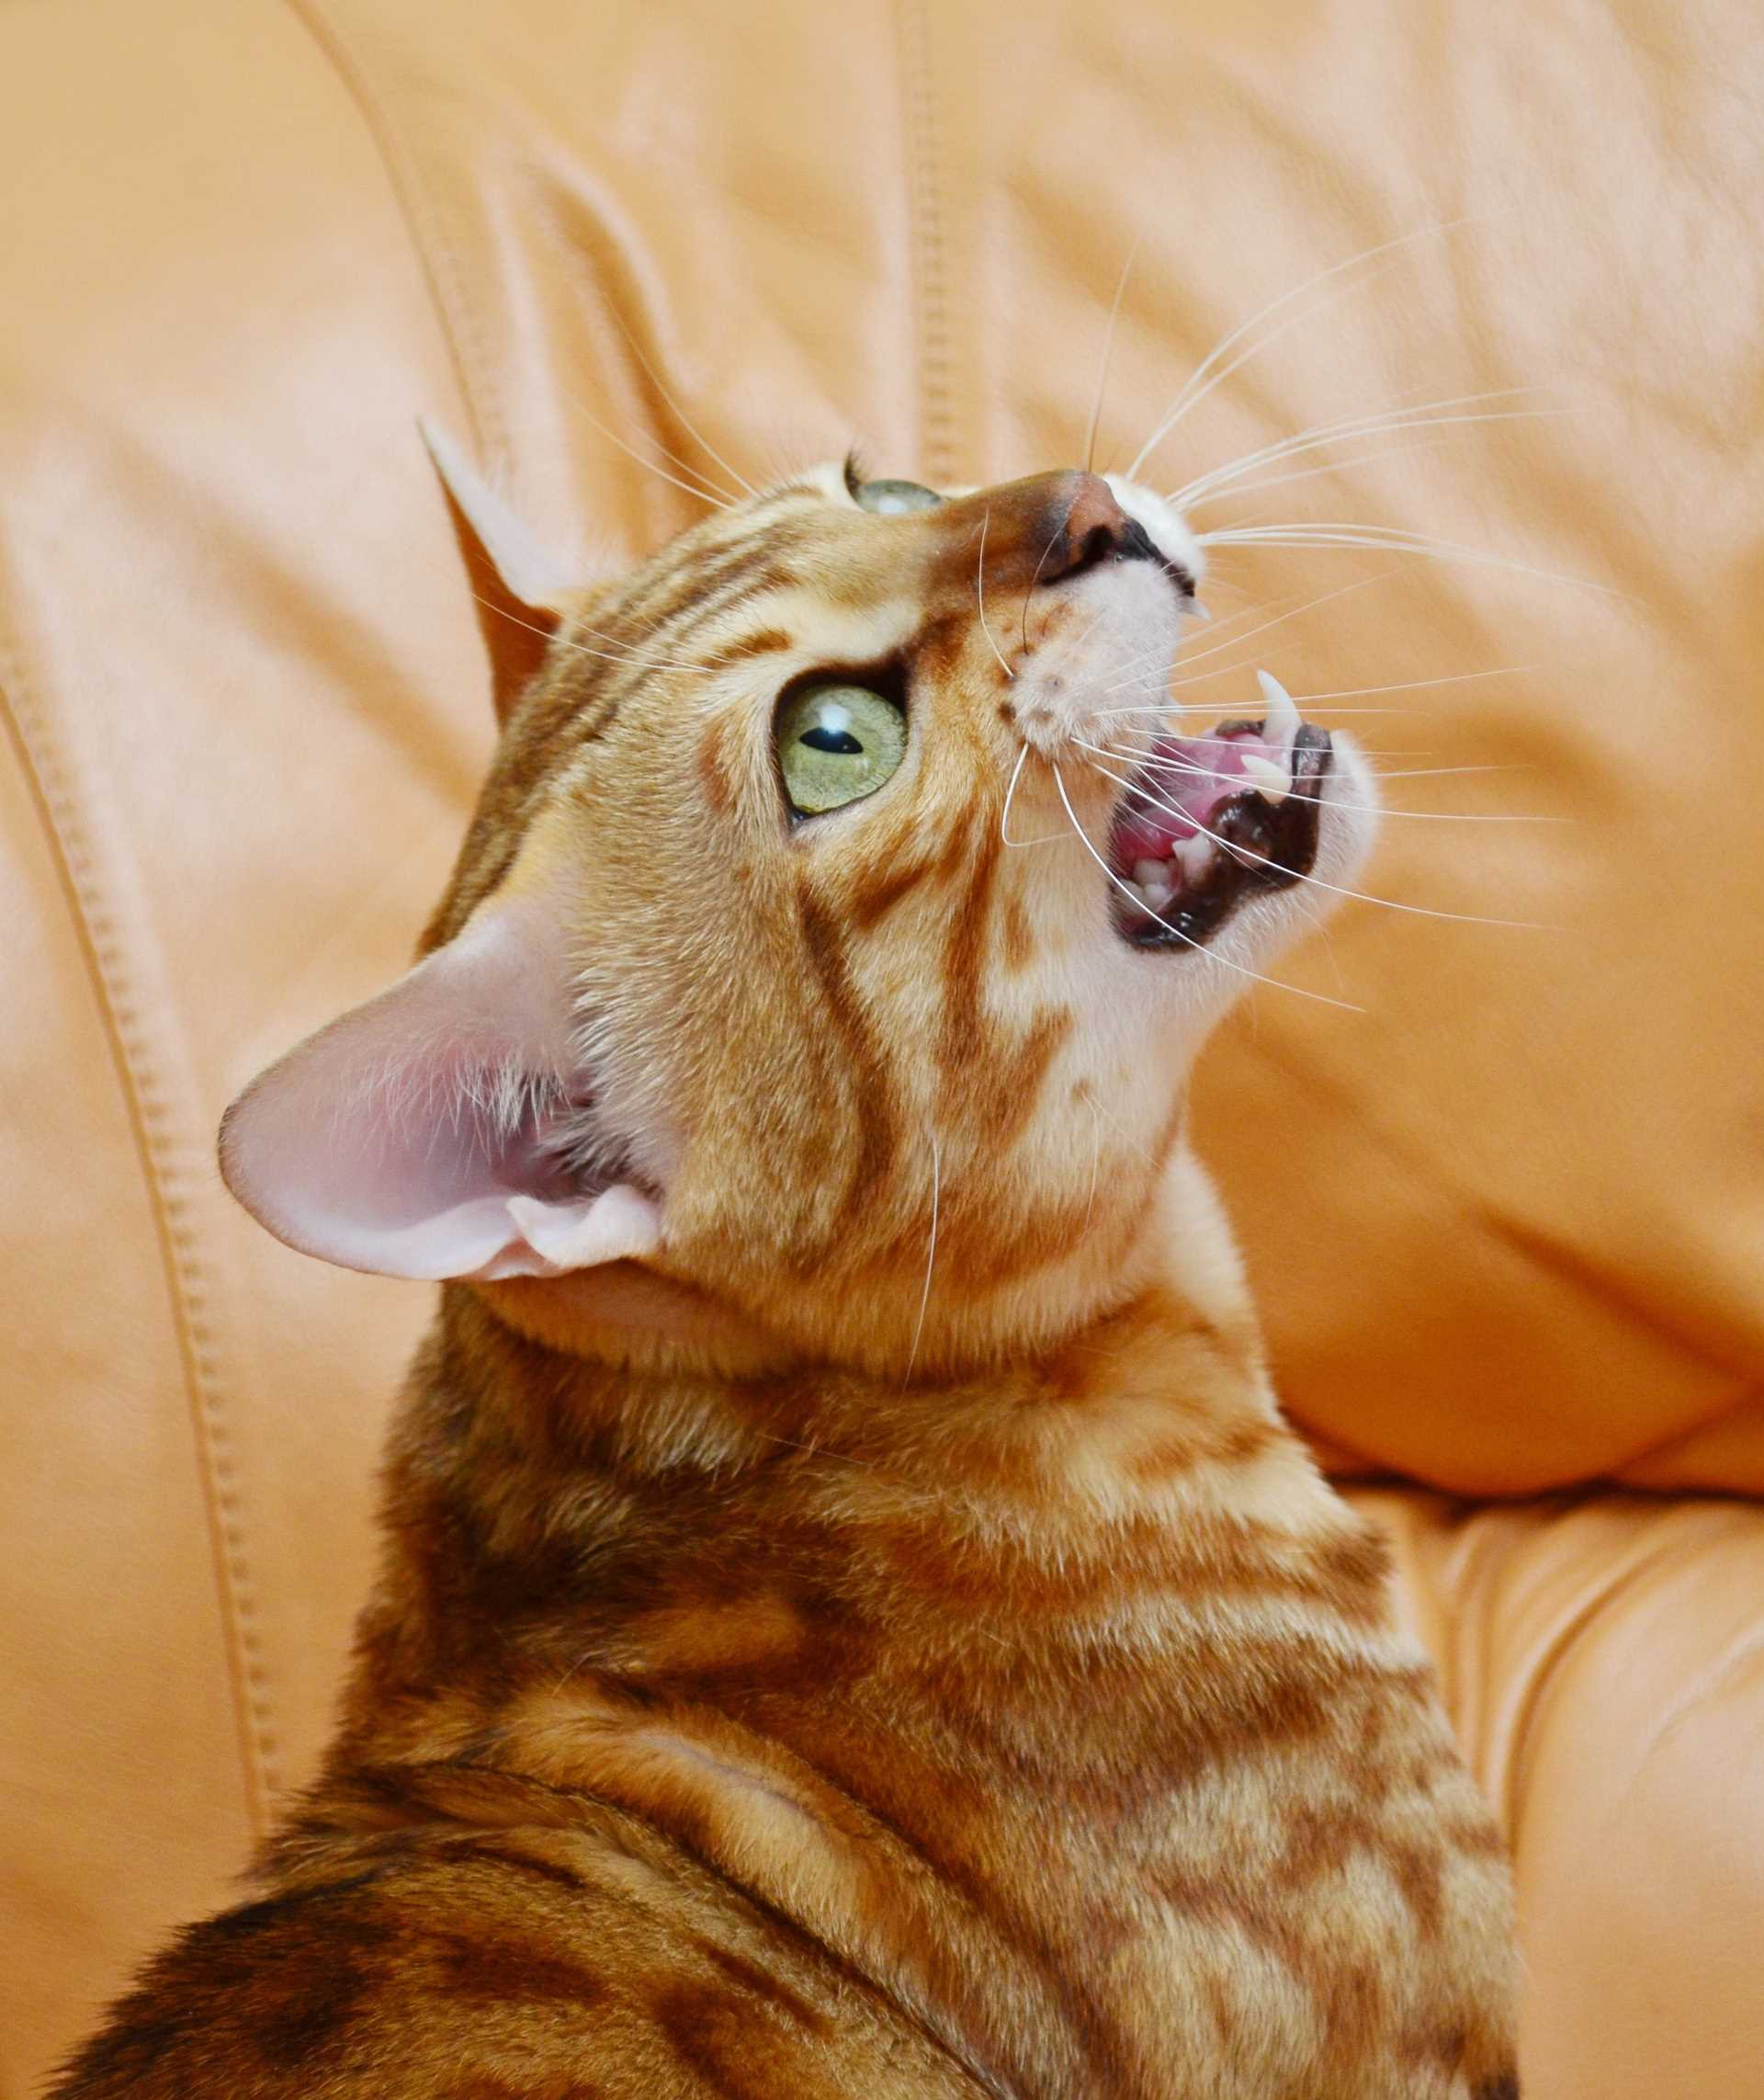

Q&A

